Slide 1
Recommender Systems
Peter Bekins, Justin Ditty, Yan Nie, Chris Steege, Kelsey Sucher

Slide 2
1. Common Applications 2. Basic Recommender Models 3. Statistical Concepts 4. Advanced Methods 5. Software Demonstration
Agenda

Slide 3
1. Common Applications
Kelsey Sucher

Slide 4
What is a Recommender System?
In the digital age we live in, people are on ‘information overload’ – consumers need a way to narrow down their options, and merchandisers need a way to stand out. This is where recommender systems have become incredibly relevant.
Recommender systems make judgements based on users’ history, social interactions, or other points of interest to generate recommendations for what to watch, buy, listen to, etc.
This can benefit both the user’s experience AND retention and credibility for the business.
By the numbers:
2/3 of watched movies on Netflix were chosen from the recommender system.
38% of clicks on Google News came from recommendations.
35% of Amazon sales were a result of their recommender system.

Slide 5
Digital Media – Netflix
Many media consumption providers utilize these systems to generate recommendations for their users.
Netflix estimates that 80% of streaming is chosen because of recommendations.
The 7,000+ options make recommendations a necessity.
What is customized?
Trailers shown upon login
Artwork/photos shown for shows
Genre options
“Recommended for you” category

Slide 6
How does Netflix do it?
Inputs
Viewer interactions with services
Categories watched
Methods
Reinforcement learning
Device used
Duration of show
Time of day of streaming
Data from other viewers with similar taste
Results
Viewer segmentation (2000+ “taste groups”)
1300+ Recommendation Clusters
Neural networks
Causal modelling
Probabilistic graphical methods
Matrix factorization
Ensembles
Bandits
Personalized, accurate recommendation for each user
Increased customer satisfaction and retention

Slide 7
Social Media – TikTok
TikTok is a relatively new social media platform that is well known for the recommender system used in its “For You Page.”
Each user’s feed is customized with a stream of videos personalized to their interests and sense of humor.
Inputs
Video likes/comments
Considerations
A continuous process to account for interest changes
Result
Consistent fresh content to keep users engaged
Accounts followed
Length of videos watched
Content created
Avoiding the “filter bubble” by inserting diversity of content
Videos to match audience interests
Notes:
Each input has different weights at which they are incorporated into the model
Considerations are unique to TikTok and represent some problems that larger social media platforms (Facebook, Instagram) have yet to solve. i.e. the “bubble” of what interests you

Slide 8
Retail – Kroger
Stores (such as Kroger) also frequently utilize recommender systems to tailor experiences to their customers’ preferences.
With 8451, Kroger utilizes shopper data such as previously purchased items and quantities to recommend products that shoppers may be interested in purchasing.
This system has become increasingly relevant and impactful on sales with the rise in ClickList orders.

Slide 9
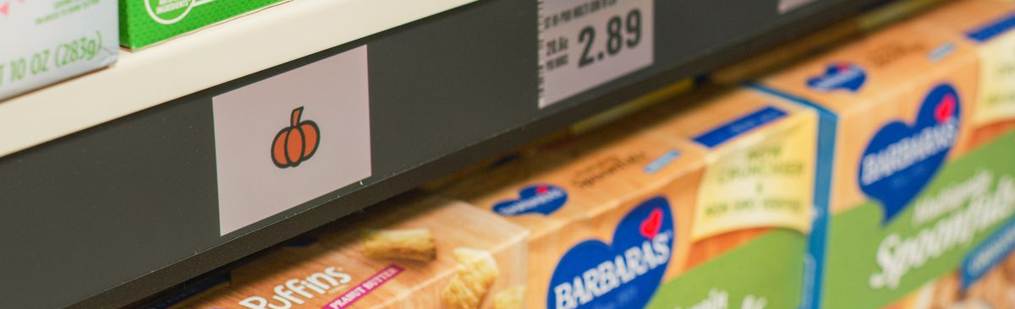
Kroger’s Digital Stores
Kroger is working with Microsoft to pilot “digital stores” in which signage is automated and customers use an app that guides them through the store to scan their groceries.
A recommender system is used in the app to recommend items customers might like and encourage purchases.
This initiative shows the increasing relevance of recommender systems.
As grocery shopping becomes more digital, there will be many more variables that can be used to increase the accuracy of recommendations.

Slide 10
eCommerce – Amazon
Amazon utilizes item-to-item collaborative filtering, recommending items that are similar to products that a user has viewed or purchased.
Similar vs. related – Amazon will recommend alternative products as well as complimentary products to increase basket size.
Because of all of their data from user accounts, Amazon is also able to provide recommendations to anonymous users who visit the site.

Slide 11
Sources
https://medium.com/@springboard_ind/how-netflixs-recommendation-engine-works-bd1ee381bf81
https://towardsdatascience.com/recommender-systems-the-most-valuable-application-of-machine-learning-part-1-f96ecbc4b7f5
https://www.theverge.com/2019/1/8/18154802/microsoft-kroger-retail-partnership-digital-signs-image-recognition-temperature-sensor
https://techcrunch.com/2020/06/18/tiktok-explains-how-the-recommendation-system-behind-its-for-you-feed-works/
http://rejoiner.com/resources/amazon-recommendations-secret-selling-online/

Slide 12
2. Basic Recommender Models
Yan Nie

Slide 13
Common Recommending Systems
User Based
Collaborative Filtering
Content based
Recommendation
Memory Based
Collaborative Filtering
Item Based
Collaborative Filtering
Recommending
Systems
Collaborative Filtering
Recommendation
Bayes Web
Model
Model Based
Collaborative Filtering
Program Based
Collaborative Filtering
Mixed
Recommendation
latent factor model

Slide 14
Content Based Recommendation
 | OnePlus 7T | OnePlus 7 | OnePlus 7 Pro
RAM | 8GB LPDDR4X | 8GB LPDDR4X | 12GB LPDDR4X
Storage | 128/256GB UFS 3.0 | 128/256GB UFS 3.0 | 128/256GB UFS 3.0
Cameras | Rear cameras Main: Sony IMX586, 48MP, f/1.6, OIS Wide: 16MP, f/2.2, 117 degrees Telephoto: 8MP, f/2.4, 2x zoom, OIS Front camera Sony IMX4791, 16MP, f/2.0, EIS | Rear cameras Main: Sony IMX586, 48MP, f/1.6, OIS Secondary: 5MP depth sensor Front camera: Sony IMX471, 16MP, f/2.0, EIS | Rear cameras: Main: 48MP, f/1.6, OIS Wide: 16MP, f/2.2, 117 degrees Telephoto: 8MP, f/2.4, 3x zoom, OIS Front camera: 16MP, f/2.0, EIS
Notes:
It is a type of recommendation system which works on the principle of similar content. If a user is watching a movie, then the system will check about other movies of similar content or the same genre of the movie the user is watching. There are various fundamentals attributes that are used to compute the similarity while checking about similar content.
Figure 1 image shows the different models of one plus phone. If a person is looking for one plus 7 mobile then, one plus 7T and one plus 7 Pro is recommended to the user.

Slide 15



How is it recommended?
Euclidean distance (7T,7)
Euclidean distance (7Pro,7)
Euclidean Distance: Distance between two points can be calculated by the equation;
Notes:
To check the similarity between the products or mobile phone in this example, the system computes distances between them. One plus 7 and One plus 7T both have 8Gb ram and 48MP primary camera.
If the similarity is to be checked between both the products, Euclidean distance is calculated. Here, distance is calculated based on ram and camera;
Euclidean distance between (7T,7) is 0 whereas Euclidean distance between (7pro,7) is 4 which means one plus 7 and one plus 7T have similarities in them whereas one plus 7Pro and 7 are not similar products.
Euclidean Distance: Distance between two points can be calculated by the equation;
There are different scenarios where we need to check about the similarities, so there are different metrics to be used. For computing the similarity between numeric data, Euclidean distance is used, for textual data, cosine similarity is calculated and for categorical data, Jaccard similarity is computed.

Slide 16


Other Scenarios
For textual data, cosine similarity is calculated
For categorical data, Jaccard similarity is computed.
Notes:
There are different scenarios where we need to check about the similarities, so there are different metrics to be used. For computing the similarity between numeric data, Euclidean distance is used, for textual data, cosine similarity is calculated and for categorical data, Jaccard similarity is computed.
Cosine Similarity: Cosine of the angle between the two vectors of the item, vectors of A and B is calculated for imputing similarity. If the vectors are closer, then small will be the angle and large will be the cosine.
Cosine Similarity
Jaccard Similarity: Users who have rated item A and B divided by the total number of users who have rated either A or B gives us the similarity. It is used for comparing the similarity.

Slide 17
Merits
There is no requirement for much of the user’s data.
We just need item data that enable us to start giving recommendations to users.
It does not suffer from a cold start.
Demerits
Items data should be in good volume.
Features should be available to compute the similarity.
Notes:
A content-based recommender engine does not depend on the user’s data, so even if a new user comes in, we can recommend the user as long as we have the user data to build his profile.

Slide 18
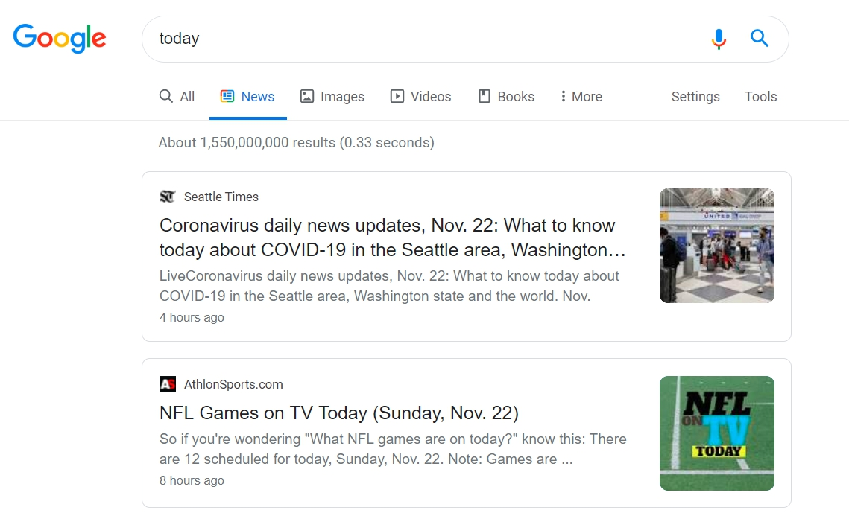
Popularity Based Recommending System
A type of recommendation system which works on the principle of popularity. These systems check about the products or movies which are in trend or are most popular among the users and directly recommend those.
Example
Notes:
Popularity is a special type of content based recommending system.
For example, if a product is often purchased by most people then the system will get to know that that product is most popular so for every new user who just signed it, the system will recommend that product to that user also and chances becomes high that the new user will also purchase that.
Google News: News filtered by trending and most popular news.
YouTube: Trending videos.

Slide 19
Merits
It does not suffer from cold start problems.
There is no need for the user's historical data.
Demerits
Not personalized.
The system would recommend the same sort of products/movies which are solely based upon popularity to every other user.

Slide 20
Collaborative filtering (CF)
Earliest and most widely used method/algorithm.
There are two types:
user based collaborative filtering or
Item based collaborative Filtering (merchandise/service based collaborative filtering)

Slide 21
User based collaborative filtering
User based collaborative filtering discovers users’ preferences from their history of behaviors (like purchase, comments and favorites). A relationship is then established among customers with similar preferences for merchandises or services. Similar items will be recommended to users in the same group.
A simple scenario is for an online bookstore, if users A and B purchased the same books, and both gave those book 5 star rating, then they will be grouped into the same user group. Then what A reads or buys could be recommended to B as well.

Slide 22
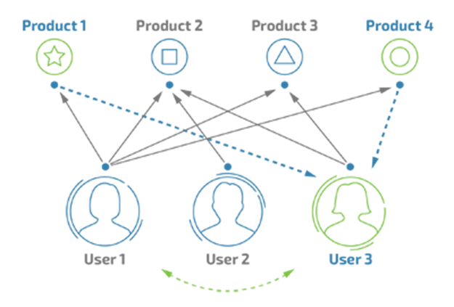
User based CF
Notes:
During analysis of user behaviors, we could identify some overlapping interests. Like user1 and user 3 share interest in product 2 and 3. User 1 and user 2 both like product 2. In this way, we can group the users with similar interests together.

Slide 23
How to identify users in the same group
A | 3.3 | 6.5
B | 5.8 | 2.6
C | 3.6 | 6.3
D | 3.4 | 5.8
E | 5.2 | 3.1
Notes:
With certain methods, we can calculate the interest of each user towards each product.
But how can we decide the which users are in the same group from there?

Slide 24
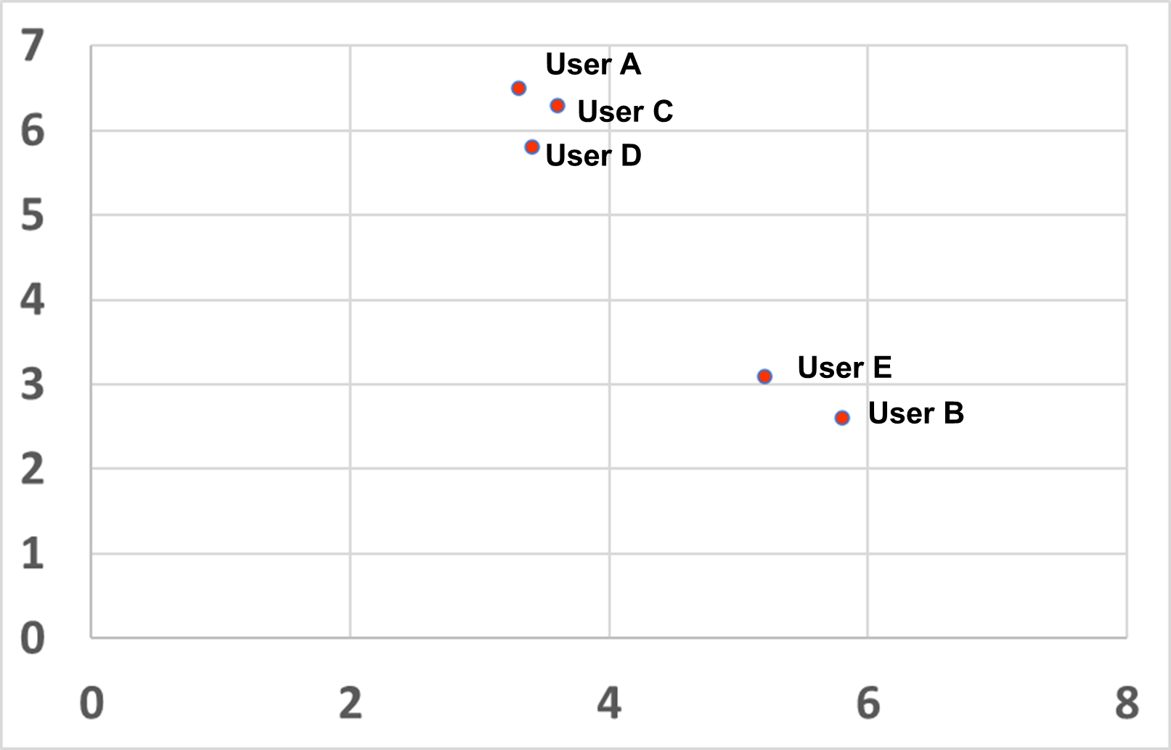
Method 1: Plotting in scatter-plot
It could be easily seen that A,C,D are close while E and B are close.
Notes:
A simple method will be to plot out their ratings, then we can easily see that ACD are closer while Eand B are close. Therefore, we can group ACD into one insterstt group and users B and E in another group.

Slide 25
Method 2: Euclidean distance
It uses the distance between users on the scatter plots to rate the relationships between users.
A | & | B | 4.63 | 0.18
A | & | C | 0.36 | 0.73
A | & | D | 0.71 | 0.59
A | & | E | 3.89 | 0.20
B | & | C | 4.30 | 0.19
B | & | D | 4.00 | 0.20
B | & | E | 0.78 | 0.56
C | & | D | 0.54 | 0.65
C | & | E | 3.58 | 0.22
C | & | E | 3.24 | 0.24
The green ones are grouped together customers. The result matches the discovery from the scatter plot.
Notes:
And we can also calculate the Euclidean distance on the scatter plots to rate the relationships between users. The green ones are groped together customers.

Slide 26
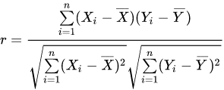
Method 3: Pearson relativity judgement
It could deal with more complicated situations:
Pearson Correlation Coefficient
A | 3.3 | 6.5 | 2.8 | 3.4 | 5.5
B | 3.5 | 5.8 | 3.1 | 3.6 | 5.1
C | 5.6 | 3.3 | 4.5 | 5.2 | 3.2
D | 5.4 | 2.8 | 4.1 | 4.9 | 2.8
E | 5.2 | 3.1 | 4.7 | 5.3 | 3.1
Notes:
Methods 3 is to calculate the pearson relativiety coefficient. This method could be used to deal with more complicated situations.

Slide 27
Relationship between X and Y
0<r<1, positive relationship
-1<r<0, negative relationship
r=1, x and y are in proportion.
r=-1, x and y are in negative proportion.
r=0, x and y are unrelated.
Notes:
The result shows that
0.8-1.0 extremely strongly related
0.6-0.8 strongly related
0.4-0.6 mildly related
0.2-0.4 weakly related
0.0-0.2 very week or no relation

Slide 28
Item based CF
Build UI matrix
Compute the similarities among items
Make up recommendation table using the most similar k items
Recommend to specific users who haven’t selected those items before
Notes:
①首先需要构建UI矩阵；
②根据UI矩阵来计算列（项目维度）的相似度；
③选择特定项目最相似的k个项目构成推荐列表；
④推荐给特定用户列表中还没有发生过行为的项目。

Slide 29
Limitations
Enough data are required to find a match. To overcome such cold start problems, often hybrid approaches are made use of between CF and Content-based matching.
Even if there are many users and many items that are to be recommended often, problems can arise of user and rating matrix to be sparse and will become challenging to find out about the users who have rated the same item.

Slide 30
Model based Collaborative Filtering Machine learning
Loss Function
Neural Network
Graph Model
Matrix decomposition

Slide 31
Sources
Tulasi K. Paradarami, Nathaniel D.Bastian, Jennifer L.Wightman, Expert Systems with Applications (2017), 83, 15, 300-313
Francesco Ricci, Lior Rokach, Bracha Shapira, Recommender Systems Handbook 2011 pp 1-35
https://zhuanlan.zhihu.com/p/30898729
https://zhuanlan.zhihu.com/p/27502172
http://www.woshipm.com/pd/4223123.html

Slide 32
3. Statistical Concepts
Chris Steege

Slide 33
What is a similarity measure?
“The similarity between two objects is a numerical measure of the degree to which the two objects are alike. Consequently, similarities are usually non-negative and are often between 0 and 1.” (Ghemri)
A similarity measure is often synonymous with computing the distance between to objects.
There are different ways to understand and compute distance:
Cosine-Similarity
Euclidean Distance
Dot Product
Etc.

Slide 34
Content-based vs. Collaborative vs. Hybrid
Content-Based Filtering
We are attempting to compute similar items a user has preferred prior.
For each user, you will relate qualities of items enjoyed with similar items in the pool.
Item – Item Similarity
Collaborative Filtering
We are computing similar users.
Items are recommended according to the items of similar users.
Similar users are determined according to users who have had similar items and gave similar implicit or explicit ratings to these items.
User – User Similarity
Hybrid
We are computing similar Items for each user and similar users.
recommended according to the items of similar users and whether these items have similar qualities of a user’s previous items.
Item – Item & User – User Similarity

Slide 35
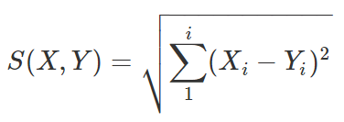
Types of Similarity Measures
3 Common Similarity Measures.
Cosine-Similarity
Give the Cosine angle between two vectors.
S(X,Y)=Cos(X,Y)=(X⋅Y)/(||X||⋅||Y||)
Dot Product
Given by taking the dot product of two vectors. This gives weight to the angle between vectors as well as magnitude.
S(X,Y)=(X⋅Y)
Euclidean Distance
Simply measures the distance between the points at the end of each vector

Slide 36
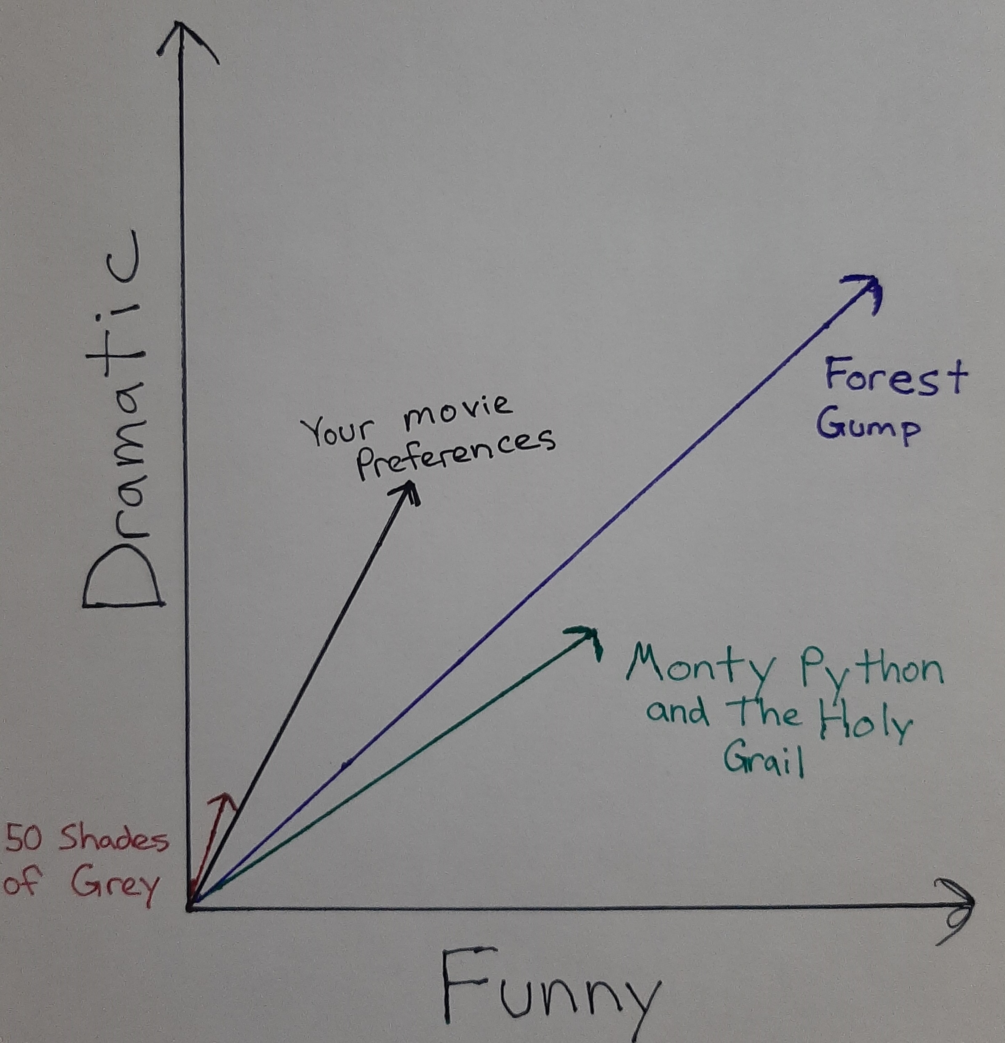
Similarity Measures Visualized
What is the most similar to your movie preferences?
Try using:
Cosine Similarity
Measures similarity by the angle between two vectors.
Dot Product
Measures similarity by the angle and magnitude -> Larger = Better.
Euclidean Distance
Distance between the endpoints of two vectors.

Slide 37
Advantages and Disadvantages
Advantages
Cosine-Similarity
This metric gives preference to items that have the most similar qualities.
Dot-Product
This metric can account for both popularity and likeness of item qualities
Euclidean Distance
Can find items according to similar popularity and likeness.
Disadvantages
Cosine-Similarity
Does not give any weight to popularity.
End up on the “strange” part of YouTube
Dot-Product
Popularity can account for too much similarity over likeness of qualities.
Euclidean Distance
May not give enough weight to popularity or similarity.

Slide 38

Some Additional Similarity Measures
Jaccard Similarity
Computes similarity by using the discrete number of common ratings between two users.
PIP Similarity (Proximity, Impact, Popularity)
Proximity – Penalizes disagreement in ratings.
Impact – How much an item is liked or disliked between users
Popularity – How do ratings between two users relate to the average rating among all users?

Slide 39
Sources
Agarwal, A., Chauhan, M., & Ghaziabad (2017). Similarity Measures used in Recommender Systems : A Study.​
Candidate Generation Overview | Recommendation Systems. (n.d.). Retrieved November 14, 2020, from https://developers.google.com/machine-learning/recommendation/overview/candidate-generation
Ghemri, L. (n.d.). Similarity Measures. Retrieved from http://cs.tsu.edu/ghemri/CS497/ClassNotes/ML/Similarity%20Measures.pdf​

Slide 40
4. Advanced Methods
Peter Bekins

Slide 41
How can we make better recommendations?
Explicit ratings require users to give feedback on items they prefer
Most users are unwilling to take the time to provide feedback
The information provided by feedback is likely biased
Implicit ratings are captured from user behavior like clicks, purchases, and views
Using implicit ratings can vastly improve the coverage
BUT implicit ratings are less informative than explicit ratings

Slide 42
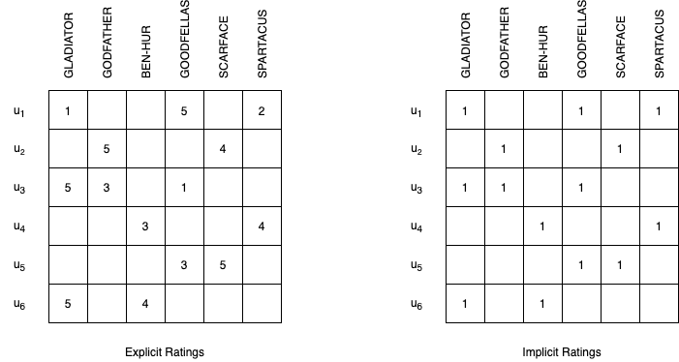
Utility Matrix with Explicit and Implicit Ratings
* Based on Aggarwal (2016: 12)

Slide 43
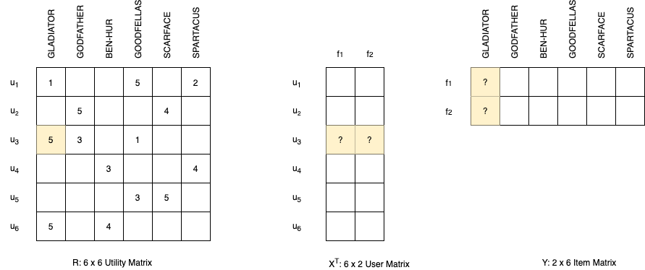
Latent Factor Model

Slide 44
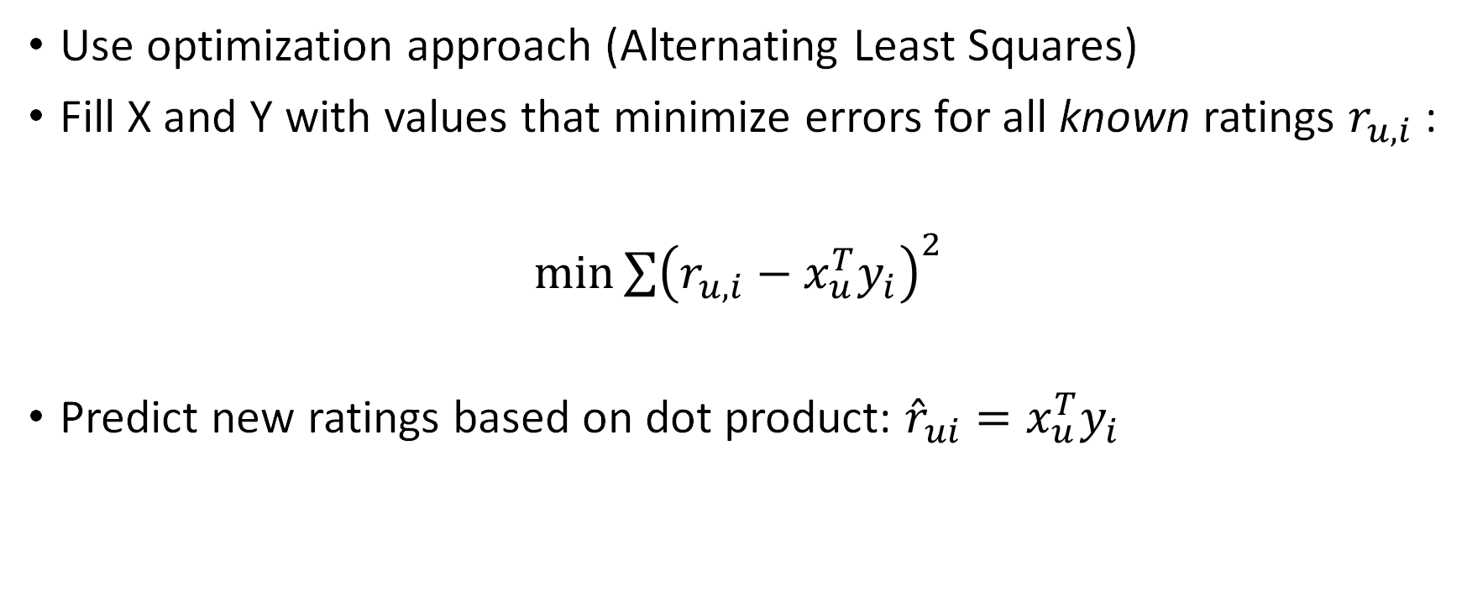
Solving for X and Y
Use optimization approach (Alternating Least Squares)
Fill X and Y with values that minimize errors for all known ratings $r_{u,i}$:
$\min{{\sum{\left(r_{u,i}−x_{u}^{T}y_{i}\right)}}^{2}}$
Predict new ratings based on dot product: ${\hat{r}}_{ui}=x_{u}^{T}y_{i}$

Slide 45
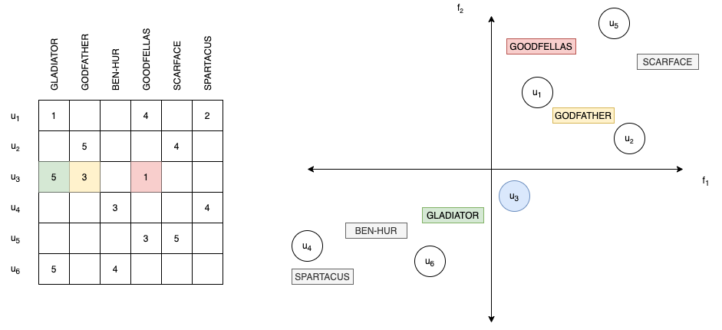
Latent Factor Space

Slide 46
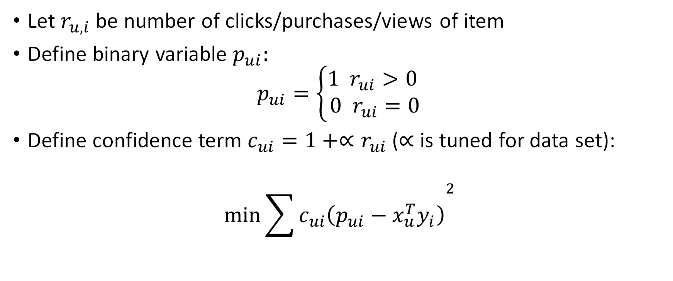
Adapt for Implicit Ratings (Hu et al. 2008)
Let $r_{u,i}$ be number of clicks/purchases/views of item
Define binary variable $p_{ui}:$
$$p_{ui}=\left\{\begin{aligned}1 r_{ui}>0 \\ 0 r_{ui}=0\end{aligned}\right.$$
Define confidence term $c_{ui}=1+∝r_{ui}$ ($∝$ is tuned for data set):
$$\min{{\sum{c_{ui}\left(p_{ui}−x_{u}^{T}y_{i}\right)}}^{2}}$$

Slide 47
Summary
Implicit ratings provide much more data for the utility matrix
But it is lower quality than explicit ratings
A collaborative filtering system with latent factor models can control the noise inherent in implicit ratings

Slide 48
Sources
Charu C. Aggarwal. 2016. Recommender Systems: The Textbook. Springer.
Hu, Y., Koren, Y., and Volinsky, C. 2008. Collaborative Filtering for Implicit Feedback Datasets. Eighth IEEE International Conference on Data Mining.
Leskovec, J., Rajaraman, A., and Ullman, J. D. 2020. Mining of Massive Datasets. 3rd Edition. Cambridge Press.

Slide 49
5. Software Demonstration
Justin Ditty

Slide 50
Introduction to Recommenderlab
Recommenderlab is a R package that provides a framework to develop and test different recommendation algorithms (Hasler 2020).
The package provides:
Functions to transform preprocessed data into similarity/rating matrices
Implementations for several content-based, collaborative, and hybrid filtering algorithms and several similarity measures
Ability to specify your own recommendation algorithm
Evaluation measures to check the performance of your recommendation systems and compare it to the performance of other recommendation systems

Slide 51
Last.fm Dataset
Last.fm (http://www.lastfm.com) was a music website that created music profiles for each of their users in order to recommend them new music.
The artists the users listen to
Each users’ friends
The artists that users friends’ listen to
Much like Spotify and Apple Music today
In 2011, The 2nd International Workshop on Information Heterogeneity and Fusion in Recommender Systems (HetRec 2011) released a Last.fm dataset containing listening information for 1,892 anonymized Last.fm users (https://grouplens.org/datasets/hetrec-2011)

Slide 52
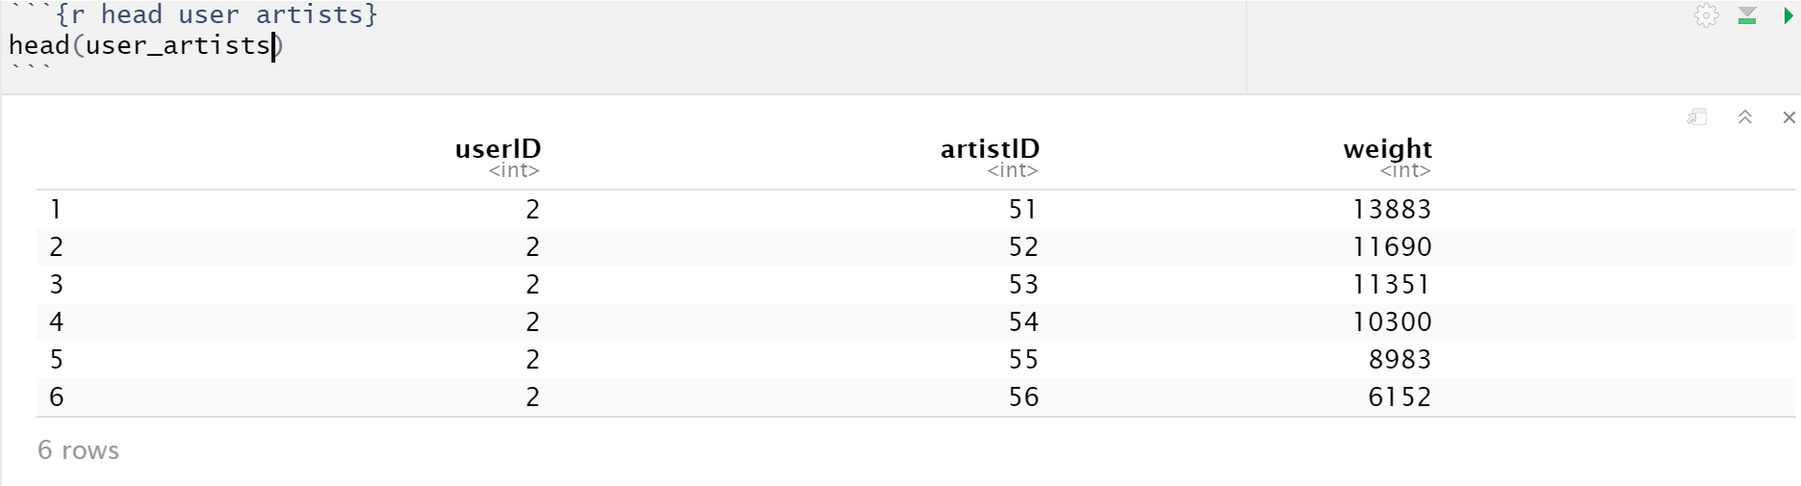
The Last.fm User Artist Data
92,834 records of each user/artist combination, along with how many times the user has listened to the artist (No record if they have never listened an artist)
1,892 Users
14,036 Artists
On average, each user listens to 49.067 artists
On average, 5.265 users listen to each artist

Slide 53
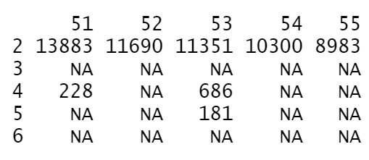
Creating a UI Matrix
First you need to transform the user/artist data into a User-Item Matrix that Recommenderlab can interpret
Recommenderlab can coerce a data frame containing user/item/number triplets into two types of sparse User-Item Matrices using as()
realRatingMatrix: data with weights (Artist plays per user)
binaryRatingMatrix: data with 1 if the user is associated with an item or 0 if they are not (1 if users are friends, 0 if they are not)
Recommenderlab uses sparse matrices to save space (NA instead of 0)

Slide 54
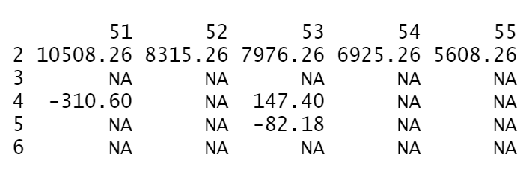
Normalizing the Data (Optional)
It is important to normalize the entries in the User-Item matrix to account an artist’s popularity by subtracting the mean number of artist listens from all the artists in the row for each user
Use the normalize() function on a realRatingMatrix
Most of the algorithms in Recommenderlab do the normalization step by default.
So you only have to do it if you specify not to normalize the data when you run your recommendation algorithm

Slide 55
Running A Recommendation Algorithm
Once you have transformed your data, you can run a recommendation algorithm using Recommender()
Recommender() implements the following algorithms:
Item-Based Collaborative Filtering (“IBCF”)
User-Based Collaborative Filtering (“UBCF”)
Hybrid ("HYBRID")
Most Popular Item (“POPULAR”)
Random Items (“RANDOM”)
More
Recommender() can use different similarity measures:
Cosine Distance (“Cosine”)
Pearson Correlation (“Pearson”)
Euclidean Distance (“Euclidean”)
More

Slide 56
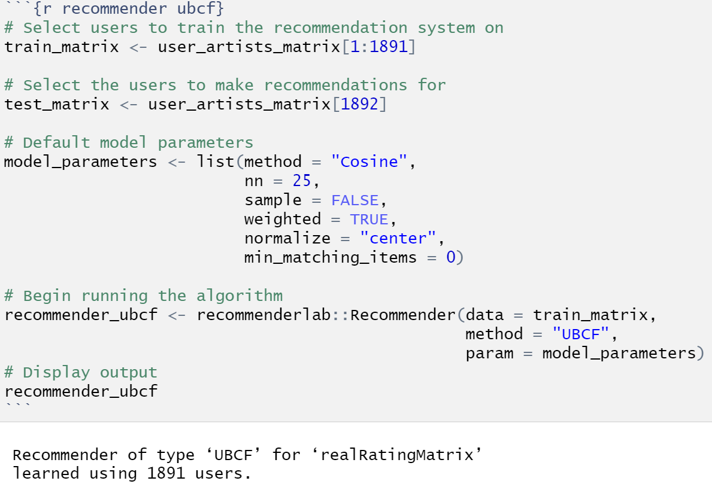
Running Recommender()

Slide 57
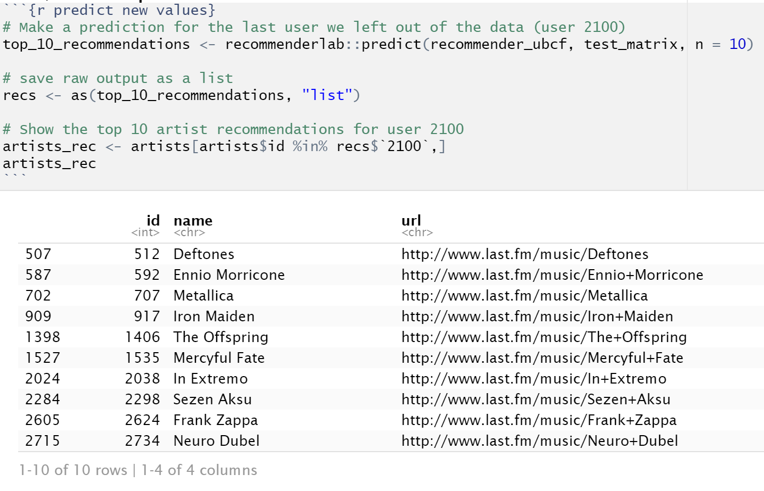
Predicting New Information
You can make recommendations for new users based on the recommender model that you created using the predict() function
You can use this to evaluate the accuracy of your recommendation system and compare it to other types of recommendation systems
k-fold Cross-Validation

Slide 58
Sources
Michael Hahsler. (2020). recommenderlab: Lab for Developing and Testing Recommender Algorithms. R package version 0.2-6. https://CRAN.R-project.org/package=recommenderlab
Last.FM. (2011). 2nd International Workshop on Information Heterogeneity and Fusion in Recommender Systems (HetRec 2011) Last.FM Dataset [Data file]. Retrieved from http://files.grouplens.org/datasets/hetrec2011/hetrec2011-lastfm-2k.zip
Ivan Cantador, P. B. (2011). 2nd Workshop on Information Heterogeneity and Fusion in Recommender Systems (HetRec 2011). Proceedings of the 5th ACM conference on Recommender systems. RecSys 2011. Chicago: ACM. Retrieved from https://grouplens.org/datasets/hetrec-2011/

